Slide 1

ECE 659 Project (Spring 2021): Improving Network Efficiency for Competitive Data Fusion in Wireless Sensor Networks using Genetic Machine Learning Algorithm
Rahul Balamurugan

Slide 2
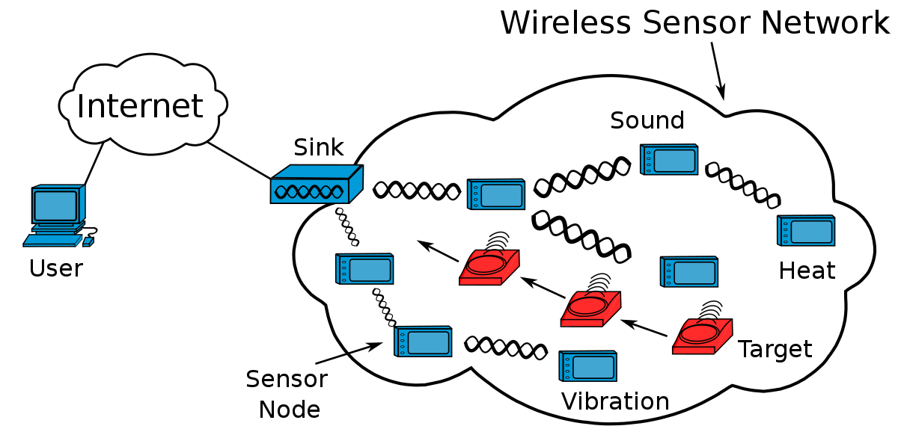
Introduction
Wireless Sensor Networks (WSNs)
Management complexity
Application objectives
Resource constraints
Densely deployed
Autonomous management
Image source: M. Bakni, Wikimedia Commons.
https://commons.wikimedia.org/wiki/File:Wireless_Sensor_Network_General_Structure.svg

Slide 3
IEEE 802.15.4 standard
Basis of Zigbee, WirelessHART protocols
Low-rate, low-power WPANs
Physical layer
Transmission rate: <=250 kbps
Transmission frequency: 868/900/2400 MHz
MAC layer
Beacon-less mode
CSMA/CA
Topologies allowed:
Star, peer-to-peer

Slide 4
Introduction (cont...)
Efficiency (Ef)
Quality of Fusion (QoF)
Sending Probability (SP)
Based on paper:
“An Approach to Implement data fusion techniques in wireless sensor networks using genetic machine learning algorithms.”
Information Fusion, vol. 15, pp. 90-101.
Pinto, A.R., Montez, C., Araujo, G., Vasquez, F., and Portugal, P. (2014, January).
Project focus: OMNET++ Implementation

Slide 5
IEEE 802.15.4 (cont...)

Slide 6
Structure of rest of the ppt:
Intro to some concepts
IEEE 802.15.4, Classifier systems, Metrics
Methodology
Network design, GMLA, Applications
Results (static, mobile)
Baseline IEEE 802.15.4
GMLA + Baseline

Slide 7
Classifier Systems
Genetic Algorithm + Machine Learning
Classifier: <condition>:<action>
If condition, then action.
Bank reward and tax -> apportionment system
Online learning => evolution during runtime
Longer execution, but adaptive

Slide 8
Network Design
Star Configuration
UDP transport protocol
IEEE 802.15.4 Physical layer, MAC (CSMA)

Slide 9
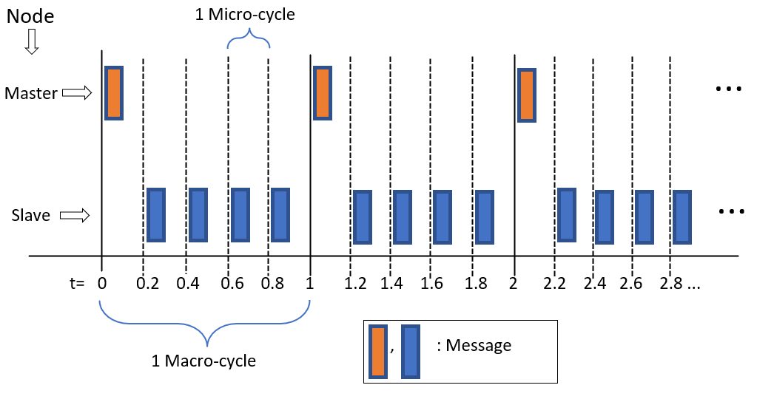
Communication flow
Master <-- radio --> {Slave1,Slave2,...SlaveN}
Macro-cycle (MA) or Monitoring cycle
Micro-cycle (MI)
1st MI of each MA:
all slaves silent,
wait for master control signal

Slide 10
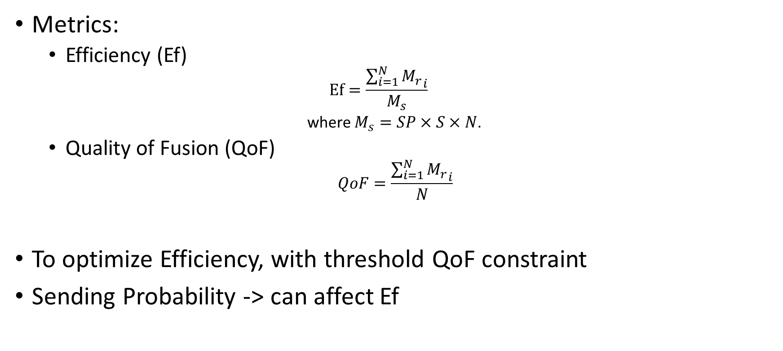
Metrics and Sending Probability
Metrics:
Efficiency (Ef)
$$Ef=\frac{\sum_{i=1}^{N}{{M_{r}}_{i}}}{M_{s}}$$
where $M_{s}=SP×S×N$.
Quality of Fusion (QoF)
$$QoF=\frac{\sum_{i=1}^{N}{{M_{r}}_{i}}}{N}$$
To optimize Efficiency, with threshold QoF constraint
Sending Probability -> can affect Ef

Slide 11
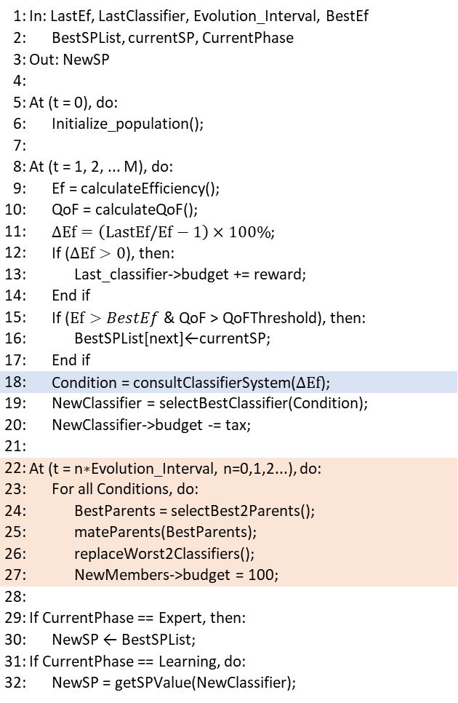
Genetic Machine Learning Algorithm
1: | In: LastEf, LastClassifier, Evolution_Interval, BestEf
2: | BestSPList, currentSP, CurrentPhase
3: | Out: NewSP
4:
5: | At (t = 0), do:
6: | Initialize_population();
7:
8: | At (t = 1, 2, ... M), do:
9: | Ef = calculateEfficiency();
10: | QoF = calculateQoF();
11: | $ΔEf=\left(LastEf/Ef−1\right)×100\%$;
12: | If ($ΔEf>0$), then:
13: | Last_classifier->budget += reward;
14: | End if
15: | If ($Ef>BestEf$ & QoF > QoFThreshold), then:
16: | BestSPList[next]←currentSP;
17: | End if
18: | Condition = consultClassifierSystem($ΔEf$);
19: | NewClassifier = selectBestClassifier(Condition);
20: | NewClassifier->budget -= tax;
21:
22: | At (t = n$∗$Evolution_Interval, n=0,1,2...), do:
23: | For all Conditions, do:
24: | BestParents = selectBest2Parents();
25: | mateParents(BestParents);
26: | replaceWorst2Classifiers();
27: | NewMembers->budget = 100;
28:
29: | If CurrentPhase == Expert, then:
30: | NewSP ← BestSPList;
31: | If CurrentPhase == Learning, do:
32: | NewSP = getSPValue(NewClassifier);
Online learning, evolution during execution
Gets condition before selecting appropriate classifiers (consults)
For every 4 classifiers having same condition, do evolution process.
Replacement: worst 2 with new members.

Slide 12
Applications
MasterApp
Compute SP using GMLA: Initialize population, evaluation, evolution (selection, crossover, mutation), replacement.
Send SP control signal periodically
SlaveApp
Get SP value periodically
Send messages based on probability (Bernoulli with p=SP)

Slide 13
Sending SP from master to slave nodes
Direct Method Call: dynamic_cast; Context switching
Enter_Method(): tell the simulator which module is being accessed
Is there a better way to go about this?

Slide 14
Simulation Results
65 Nodes control case
65 Nodes GMLA (both static)

Slide 15
Simulation Results (cont...)
Efficiency, QoF v. nNodes (IEEE)

Slide 16
Simulation Results (cont...)
Ef, QoF v. nNodes (GMLA)

Slide 17
Conclusions
Better code, more randomization
More natural control method needed
Estimates may be off for number of messages sent
Further study into appropriate learning cycle length
Optimization of GMLA method required
GMLA makes IEEE 802.15.4 network run more smoothly and more efficiently
GMLA implemented successfully; Simulation results from paper verified.

Slide 18
Test your Understanding
How is evolution in GMLA different from evolution in Genetic Algorithm?
What does the metric Ef measure?
Why is the Enter_Method() or Enter_Method_Silent() function necessary when calling a method in another module in OMNET++?

